Slide 1

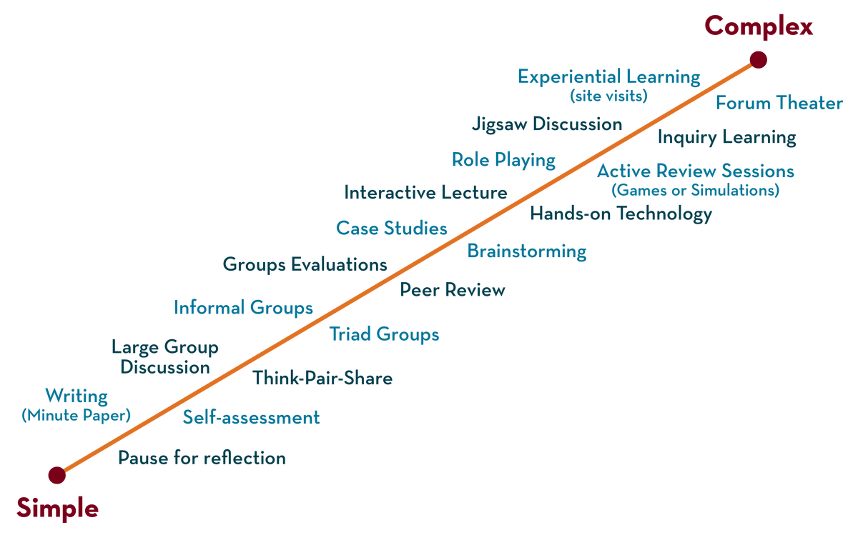
Department of ECE
COURSE: Processors and Controllers
COURSE CODE:22EC2106
Motion Detector Using MSP430 Launchpad and PIR Sensor
Presented by
2210040144-B ARYAN SAI
2210040047-K R LOKESH KUMAR
2210040002-YADNYA
2210040021-SHREYA

Slide 2



AIM OF THE PROJECT
.
The aim of creating a motion detector using an MSP430 Launchpad and a PIR sensor is to design a system that can detect motion or human presence in the environment and provide an output with respect to that detection.

Slide 3
PROJECT OBJECTIVES
This Session is designed to:
1. The PIR sensor can be used to trigger an alarm or notification when motion is detected, enhancing security.
2, Motion detectors can be part of a home security system, triggering alarms, sending alerts to homeowners or security companies, and deterring potential burglars.
3. Motion detectors can be used for safety applications, such as automatic door openers, elevator call buttons, and fall detection systems for the elderly or individuals with disabilities.

Slide 4
PROJECT OUTCOMES
The primary purpose of this project is to detect motion or movement within the sensor's field of view. When motion is detected, the system can trigger specific actions or responses.
By integrating this motion detector into a larger security system, you can enhance the security of your home or workspace. When unauthorized motion is detected, it can trigger an alarm or send a notification to alert you.

Slide 5
PROJECT INTRODUCTION
A motion sensor, or motion detector, is an electronic device that uses a sensor to detect nearby people or objects. Motion sensors are an important component of any security system. When a sensor detects motion, it will send an alert to your security system, and with newer systems, right to your mobile phone.
A Motion Detector Using MSP430 Launchpad and PIR Sensor is a DIY electronic project that combines the power of the MSP430 Launchpad microcontroller with a Passive Infrared (PIR) sensor to create a motion detection system.
The MSP430 Launchpad serves as the central processing unit in this project, where it receives signals from the PIR sensor and processes them to detect motion. The PIR sensor, on the other hand, is designed to detect changes in infrared radiation caused by moving objects. When motion is detected, the MSP430 can be programmed to perform various tasks, making it a versatile solution for home security, automation, or other applications where motion detection is important.

Slide 6
PROJECT DESCRIPTION
A Motion Detector using an MSP430 Launchpad and a PIR (Passive Infrared) sensor is a popular project in the field of electronics and home automation. This project utilizes the MSP430 Launchpad, a microcontroller development board, and a PIR sensor to create a system that can detect motion or movement within its proximity.
Signal Processing:
User Interaction:
Power Management:
Installation and Use:

Slide 7
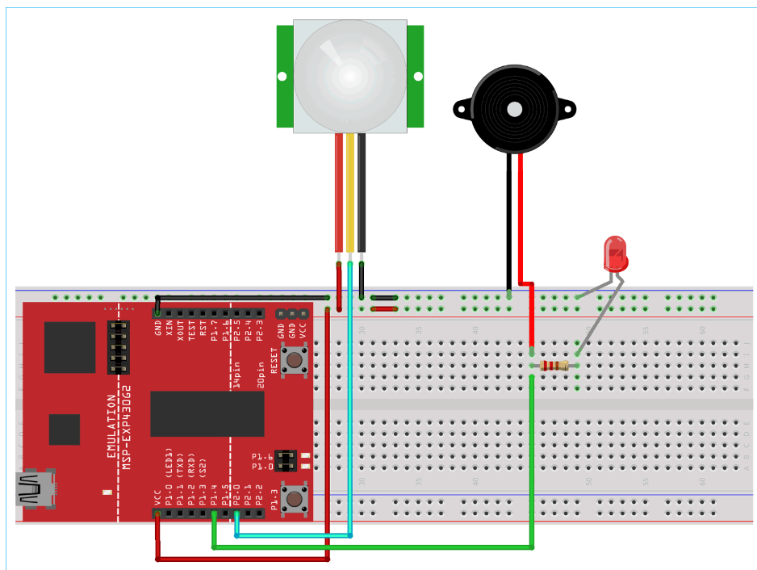
BLOCK DIAGRAM

Slide 8
HARDWARE & SOFTWARE REQUIREMENTS
Hardware required:
PIR Sensor Module
TI-MSP430 Launchpad
LED
Buzzer
Breadboard
Jumper wires
Software Required:
1. MSP430 Programming device

Slide 9
FUTURE SCOPE & ITS APPLICATIONS
The combination of a Motion Detector using an MSP430 Launchpad and a PIR has several potential future scope and applications, especially in the field of IoT (Internet of Things) and smart technology. Here are some possibilities:
Intrusion detection and security: The system can be integrated into home security systems to detect unauthorized movements and trigger alarms or notifications.
Lighting control: Automatically turn on lights when motion is detected and turn them off
Fall detection: Monitor the movement of elderly or vulnerable individuals and trigger alerts in case of a fall or prolonged inactivity.
Sleep pattern analysis: Track sleep quality and patterns to provide insights for improving sleep health.

Slide 10
TEAM MEMBERS DETAILS
2210040144-B ARYAN SAI
2210040047-K R LOKESH KUMAR
2210040002-YADNYA
2210040021-SHREYA

Slide 11
REFERENCES OF THE PROJECT
Reference Books:
Microprocessor 8086: Architecture, Programming and Interfacing Paperback, by Mathur S, Jan 2011
Microcomputer Systems: The 8086/8088 Family Architecture Programming and Design, by Dr. Glenn A Gibson, Yu-Cheng Liu
Sites and Web links:
1. https://userpages.umbc.edu/~squire/intel_book.pdf
2.https://www.researchgate.net/publication/350870710_8086_microprocessor_and_interfacing_and_others

Slide 12
THANK YOU
22EC2106 – Processors and Controllers

